Slide 1

Federated ML Sys for Fairness
Jade Preston & Navya Annapareddy
PhD Degree Program
School of Data Science
University of Virginia
Notes:
Jade

Slide 2
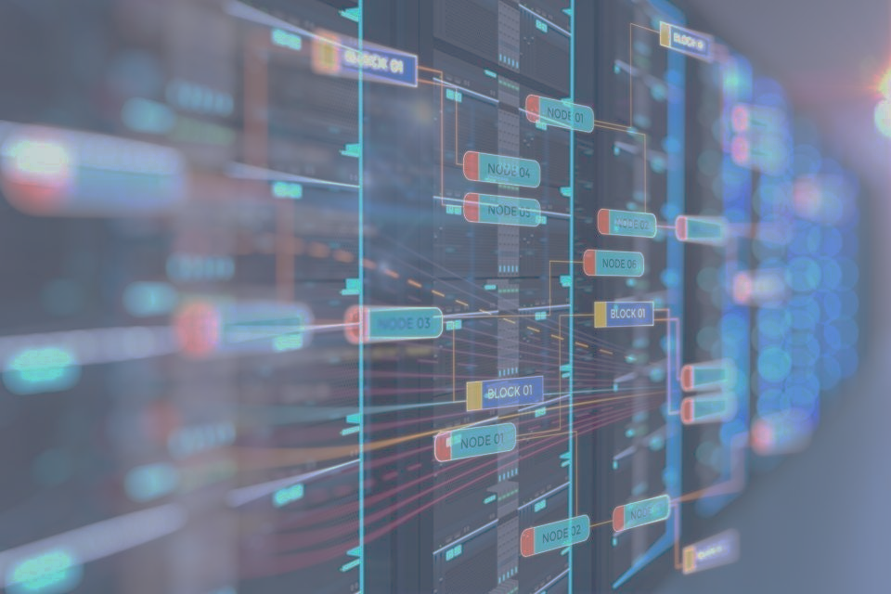
Agenda
Problem Description
Literature Review
Potential Research Gap(s)
FL Implementations
Proposed Contribution
Notes:
Jade

Slide 3
Problem Description
Data sharing is often difficult or constrained by security and distribution limitations
Healthcare data is often governed by data-use-ordinances like HIPAA
Large sample sizes allow models to generalize for more variability
Federated learning is a type of distributed learning framework
Allows data to be trained in a decentralized manner
Addresses data security, privacy, and vulnerability considerations
Some challenges to federated learning include:
Node data may not be independent and identically distributed (iid)
High levels of communication between network machines is needed
Heterogeneity in the individual nodes with respect to bias and size of data samples
Notes:
Jade

Slide 4
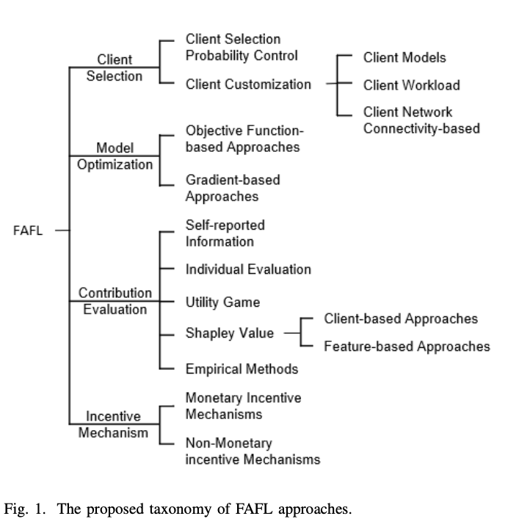
Review: Surveys on Fairness in Federated Learning
Towards Fairness-Aware Federated Learning, Shi et al. (2021)
Discuss ideal metrics but do not benchmark
Created FL taxonomy of approaches
Categorized fairness approaches
Accuracy Parity
Good Intent Fairness
Selection Fairness
Contribution Fairness
Regret Distribution Fairness
Expectation Fairness
Notes:
Navya
https://arxiv.org/pdf/2111.01872.pdf

Slide 5
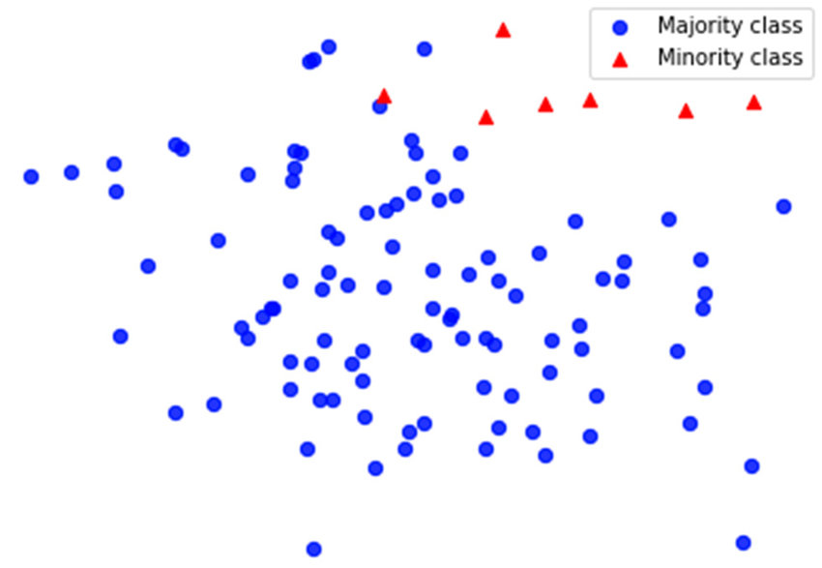
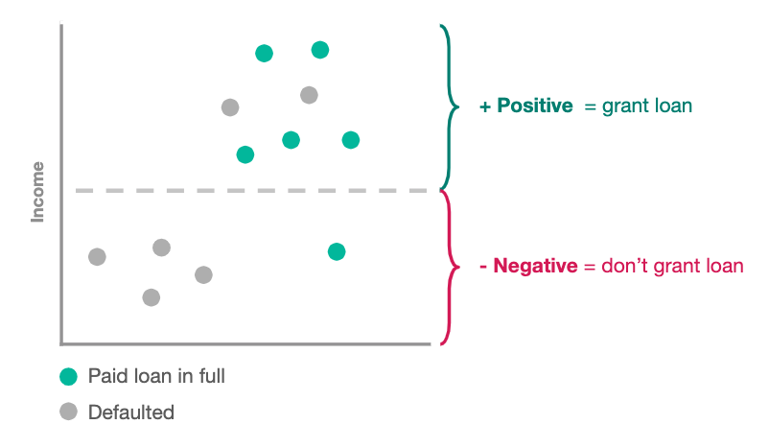
Review: Surveys on Fairness in Federated Learning
Survey on Fairness Aware Machine Learning, Quy et al. (2021)
Examines bias in federated learning datasets in different domains
Financial, Healthcare, Synthetic
Explored fairness challenges
Cardinality + imbalance
Independence
Identified fairness approaches
Multi-discrimination
Temporal fairness
Distributional fairness
Notes:
Navya
https://arxiv.org/pdf/2110.00530.pdf

Slide 6
Identified Research Gaps
Out of date categorization of existing implementations by approach
Metric based, resource allocation based
Existing fairness surveys focus on tabular data
Lack of consideration for image and other high dimensional datasets
No comprehensive unified benchmark study
Difficulty in aligning metrics
Across implementations and domains
Across image vs. tabular datasets
Notes:
Navya

Slide 7
Implementation Papers | Type | Metric
FedScale: Benchmarking Model and System Performance of Federated Learning at Scale | Image, Video, Text Audio | Accuracy, Loss
Federated Learning on Clinical Benchmark Data: Performance Assessment | Signal (ECG), Image | AUROC and F1
Fair Federated Learning via Bounded Group Loss | Text | Custom Loss
Fairness and Accuracy in Federated Learning | Synthetic Image, Text | Accuracy, Loss
A Reputation Mechanism Is All You Need: Collaborative Fairness and Adversarial Robustness in Federated Learning | Image, Text | Pearson Correlation Coefficient
Ditto: Fair and Robust Federated Learning Through Personalization | Image, Text | Accuracy, variance of robustness
Utility Fairness for the Differentially Private Federated Learning | Image | Accuracy; negative log likelihood loss
Resource Management and and Model Personalization for Federated Learning over Wireless Edge Networks | Image | Accuracy, Loss

Slide 8
Proposed Contribution (Survey)
*New contribution
Comprehensive survey according to considerations by fairness approach
Identify existing text, image, and other high dimensional implementations
Differentiate fairness approach and update w.r.t taxonomy
Differentiate unsupervised vs. supervised
Create discrete model process representation (ie: pre-training vs. post)
Classify security and scaling considerations in context of fairness
Security of aggregation/model sending*
Robustness and non IID data*
Scalability (esp. adding peers)
Identify areas of challenges and remaining potential of contribution
Metric alignment
Notes:
Navya

Slide 9
References
https://arxiv.org/pdf/2110.00530.pdf
https://arxiv.org/pdf/2111.01872.pdf
https://arxiv.org/pdf/2105.11367.pdf
https://www.ncbi.nlm.nih.gov/pmc/articles/PMC7652692/
https://arxiv.org/pdf/2203.10190
https://arxiv.org/pdf/2012.10069
https://arxiv.org/pdf/2011.10464
http://proceedings.mlr.press/v139/li21h/li21h.pdf
https://arxiv.org/pdf/2109.05267
https://www.mdpi.com/2224-2708/10/1/17/pdf?version=1616039824
Notes:
Jade

Slide 10
Questions?

